Slide 1
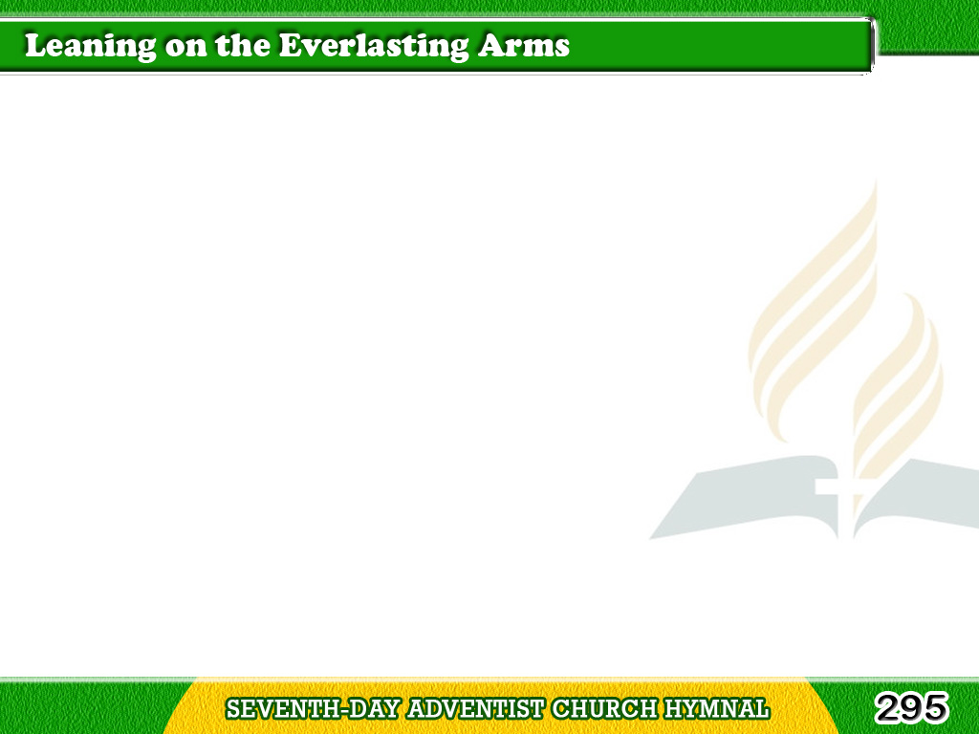
1/3
What a fellowship,
what a joy divine,
Leaning on the everlasting arms;
Tagalog
Version

Slide 2
1/3
What a blessedness,
what a peace is mine,
Leaning on the everlasting arms.
Tagalog
Version

Slide 3
1/3
Chorus
Leaning, leaning,
Safe and secure from all alarms;
Leaning, leaning,
Leaning on the everlasting arms.
Tagalog
Version

Slide 4
2/3
O how sweet to walk
in this pilgrim way,
Leaning on the everlasting arms;
Tagalog
Version

Slide 5
2/3
O how bright the path
grows from day to day,
Leaning on the everlasting arms.
Tagalog
Version

Slide 6
2/3
Chorus
Leaning, leaning,
Safe and secure from all alarms;
Leaning, leaning,
Leaning on the everlasting arms.
Tagalog
Version

Slide 7
3/3
What have I to dread,
what have I to fear,
Leaning on the everlasting arms?
Tagalog
Version

Slide 8
3/3
I have blessed peace
with my Lord so near,
Leaning on the everlasting arms.
Tagalog
Version

Slide 9
3/3
Chorus
Leaning, leaning,
Safe and secure from all alarms;
Leaning, leaning,
Leaning on the everlasting arms.
Tagalog
Version

